Slide 1
Rectilinear MIMO-SAR 3-D Image Enhancement by FCNN
Josiah W. Smith

Slide 2
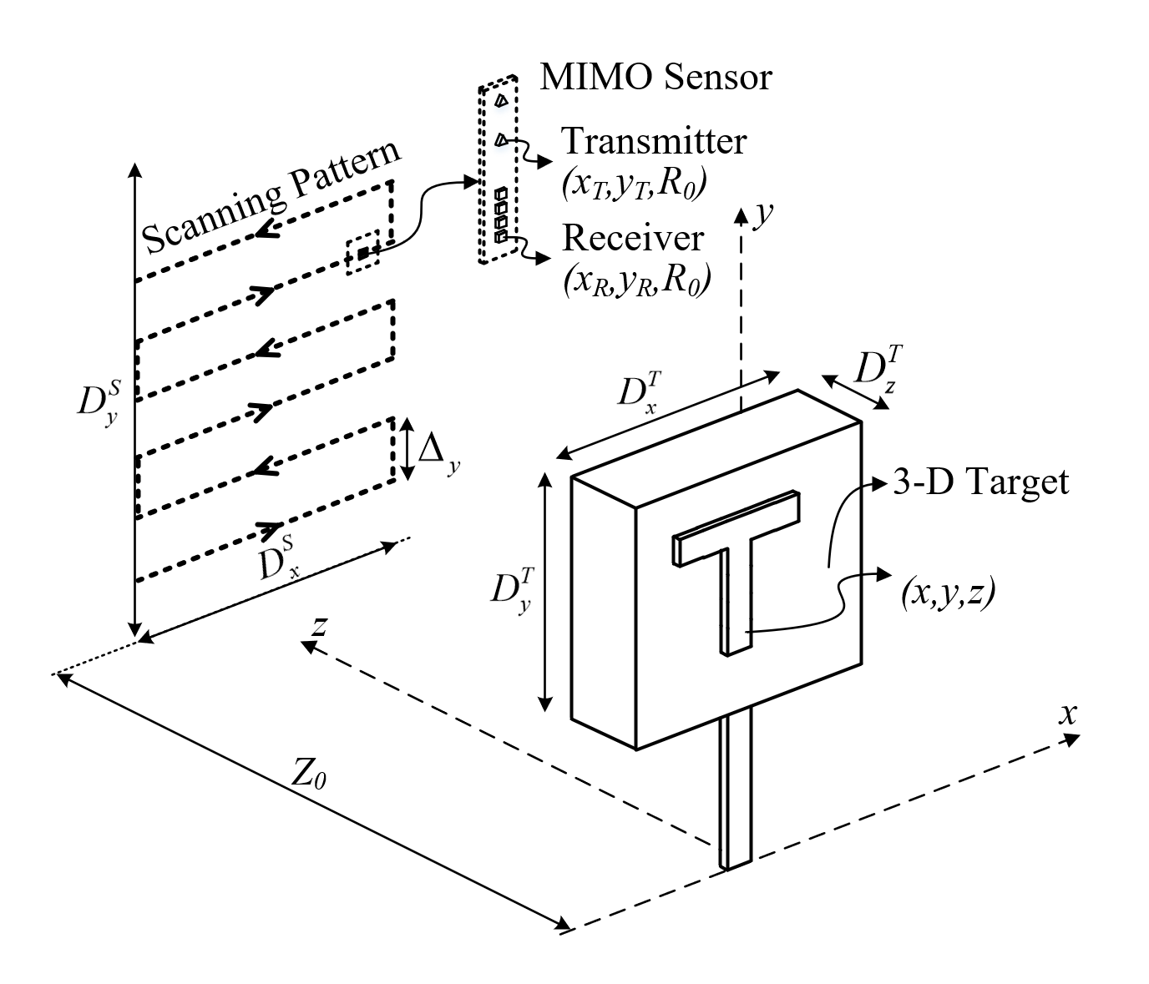
SAR Scenario
xWR1x43 radar using 8 virtual channels
Scanned in planar pattern
3-D target in the near-field

Slide 3
First Network Training
256 horizontal antenna locations
256 virtual vertical antenna locations
79 ADC samples (4GHz bandwidth)
1024 echo signals with points at random locations
No amplitude range decay term (path loss)
Training Data:
1024 reconstructed images (after mult-to-mono phase correction)
1024 ideal images assuming ideal points are narrow Gaussian pulses
Network learns distortions introduced by RMA approximations and physical limitations (aperture size, bandwidth constraints, etc.)

Slide 4
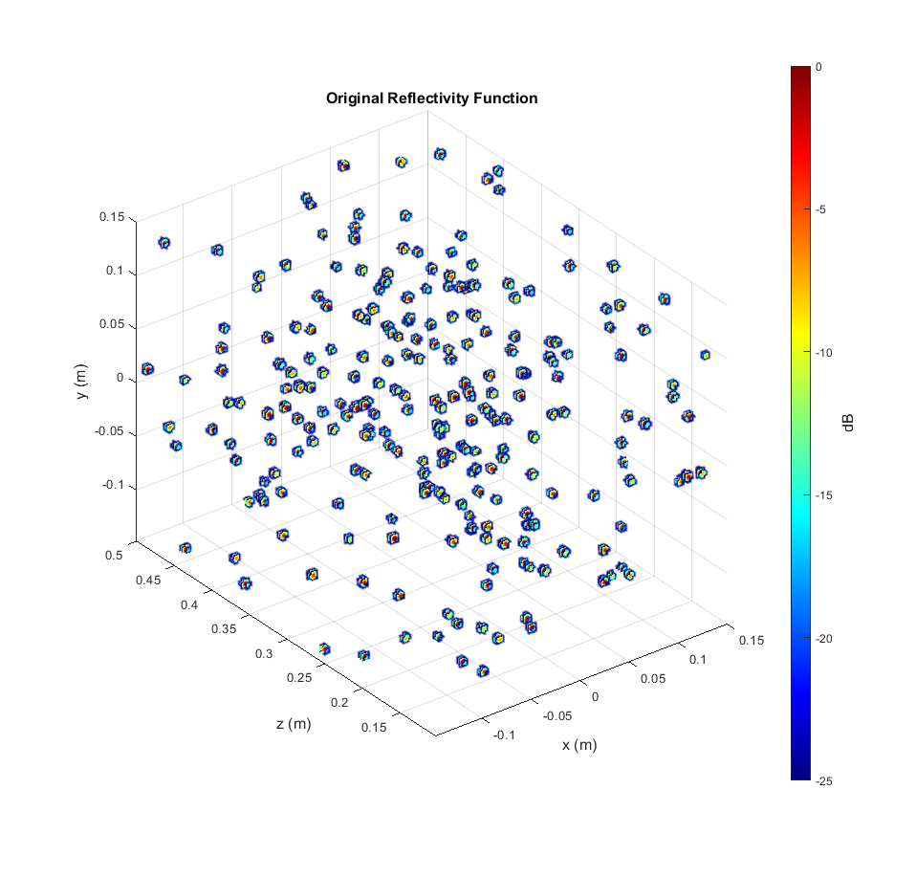
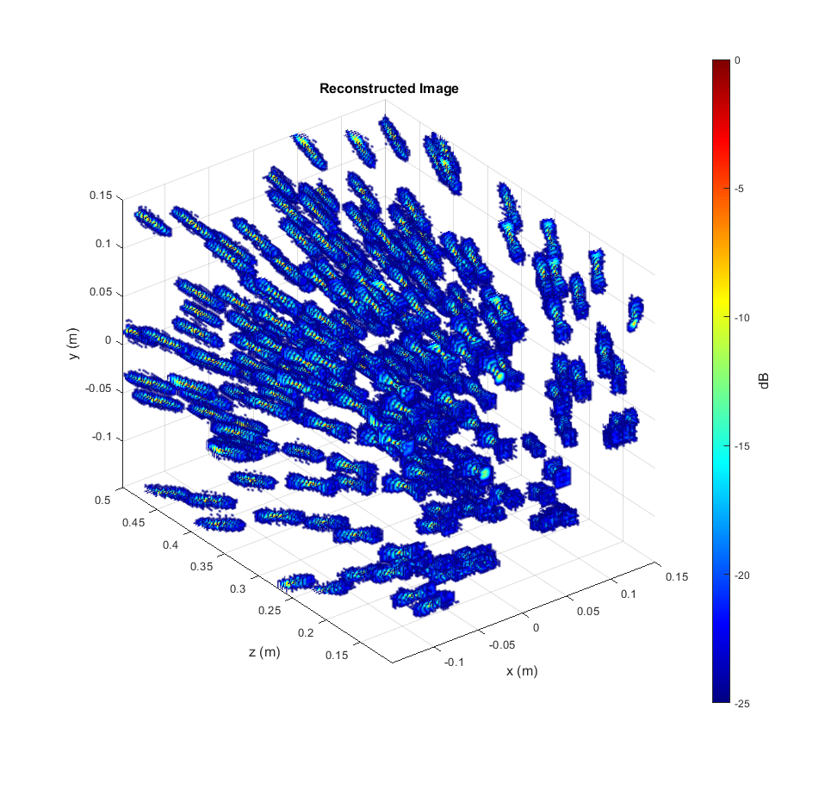
Results – Random Points

Slide 5
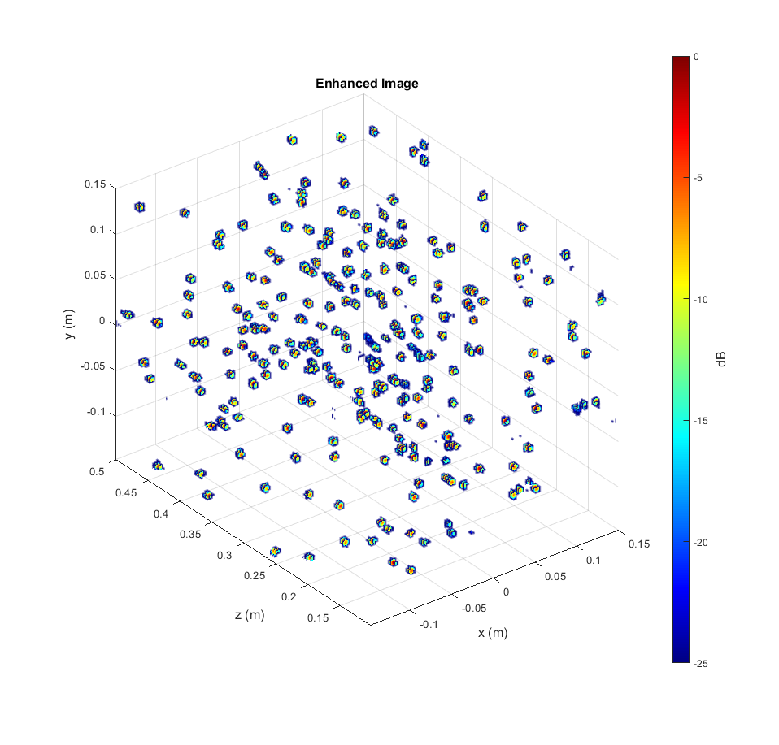
Results – Random Points
Notice distortion in the reconstructed image is largely mitigated by the FCNN
Now, individual points are much more highly resolved
The algorithm is more than just a thresholding as it removes the spatially variant distortions

Slide 6

Results – Random Points
The algorithm has never seen these positions before, but knows the distortions introduced by the finite aperture and bandwidth

Slide 7
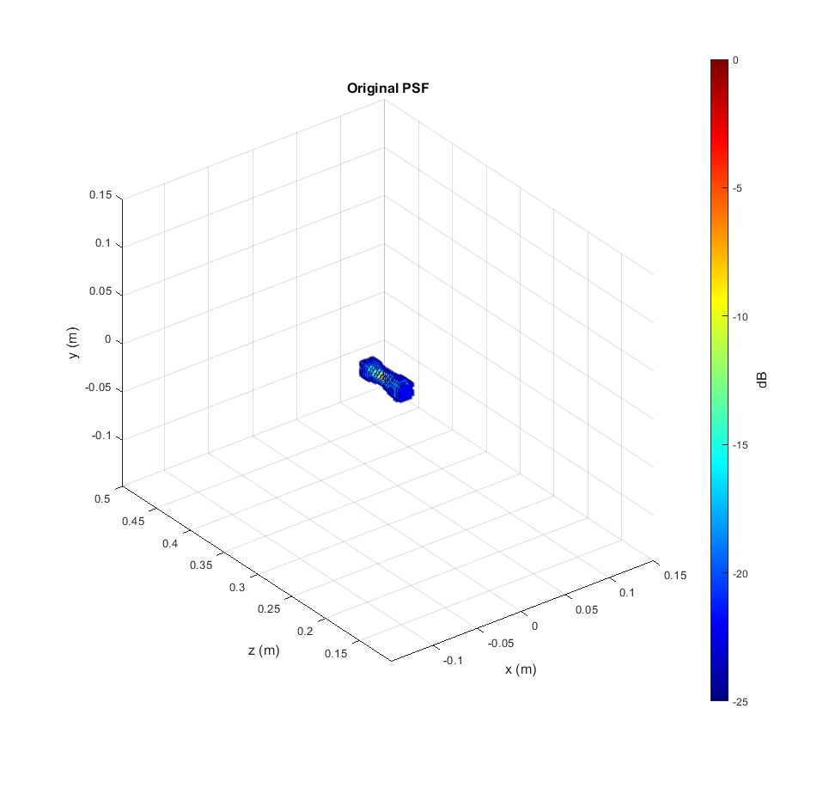
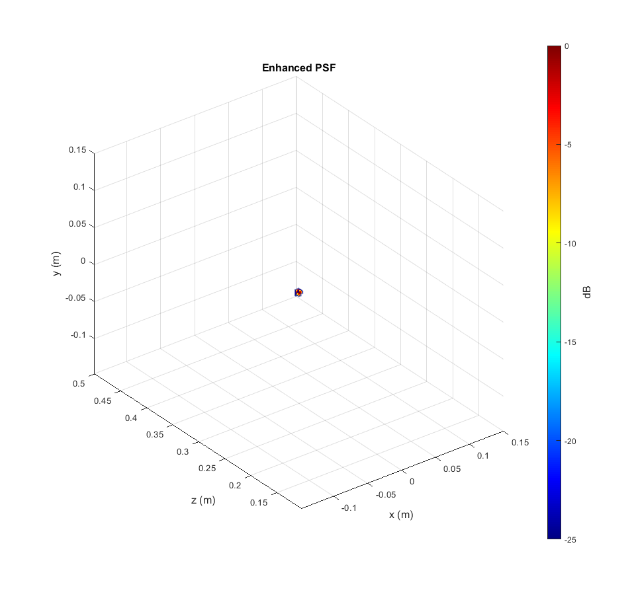
Results – PSF
FCNN can enhance the image and mitigate distortions in all three spatial dimensions
The algorithm has never seen these positions before, but knows the distortions introduced by the finite aperture and bandwidth

Slide 8
Results – PSF

Slide 9
Results – PSF

Slide 10
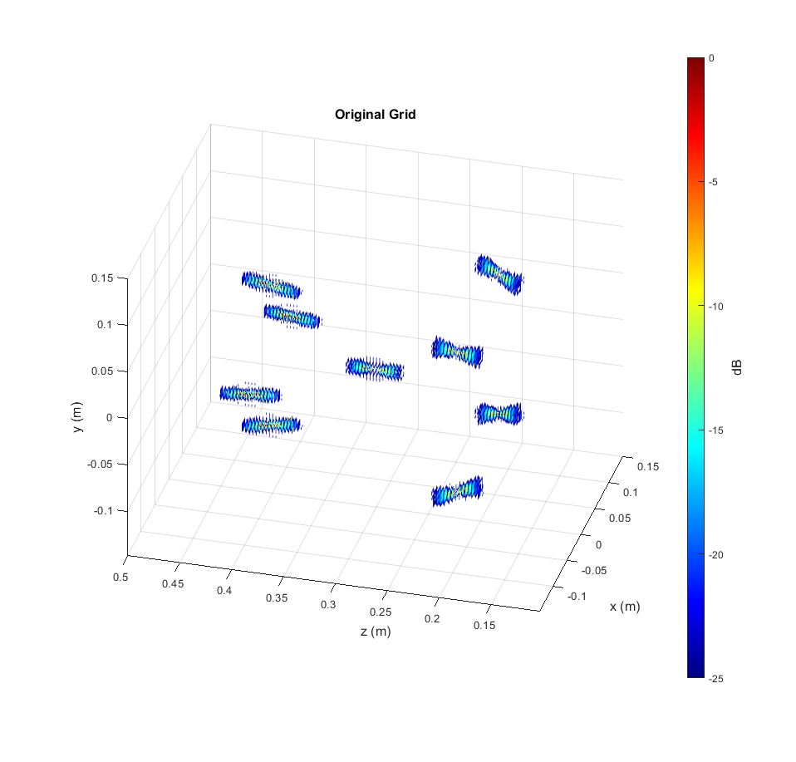
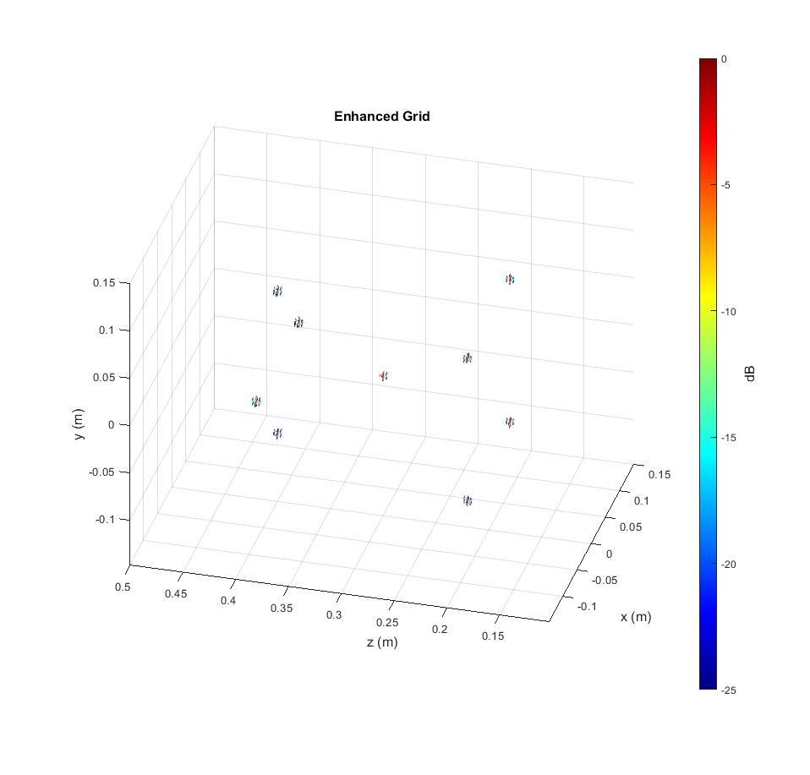
Results – Grid of Points
Notice distortion is spatially variant, but FCNN still remains robust
The algorithm has never seen these positions before, but knows the distortions introduced by the finite aperture and bandwidth

Slide 11
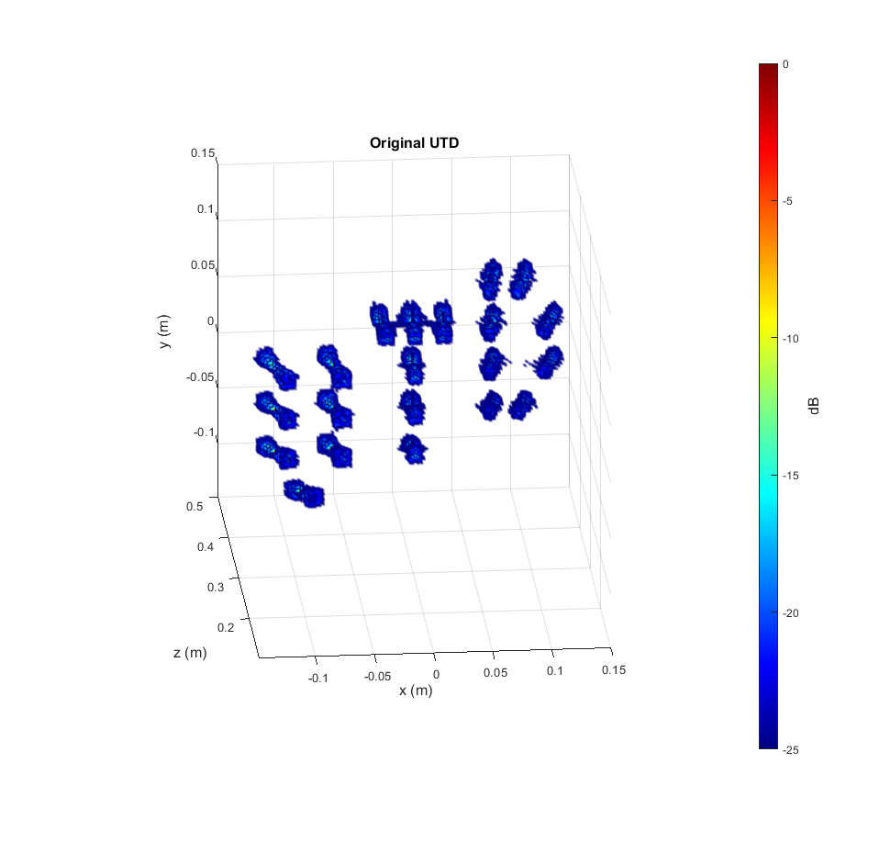
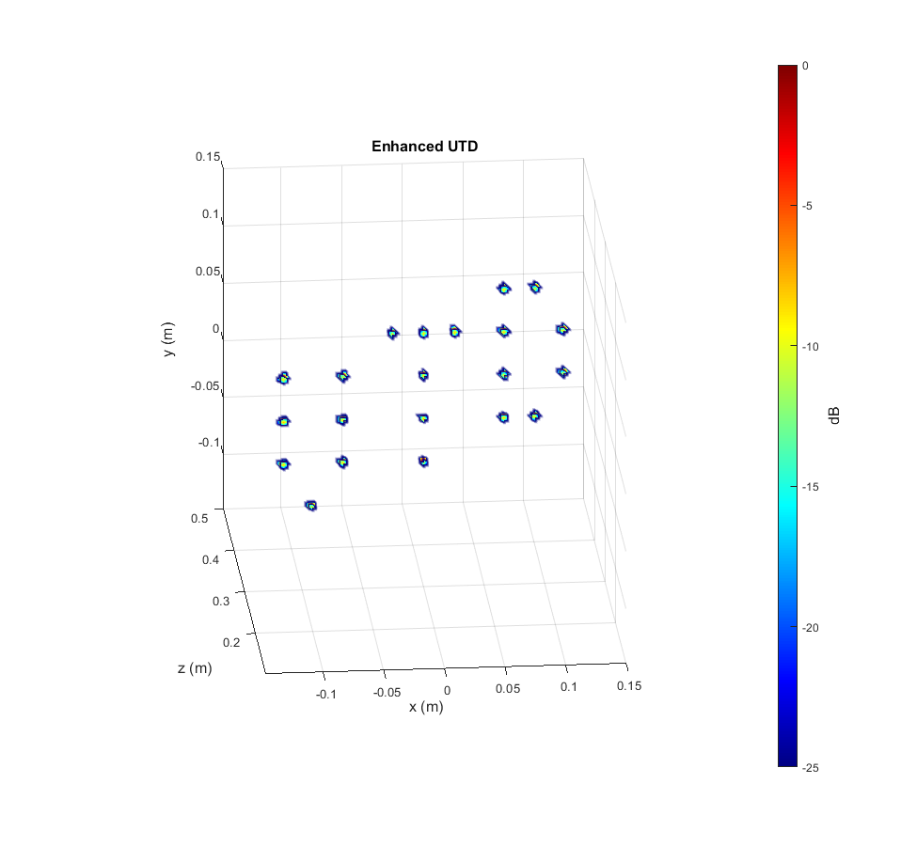
Results – UTD
The algorithm has never seen these positions before, but knows the distortions introduced by the finite aperture and bandwidth

Slide 12
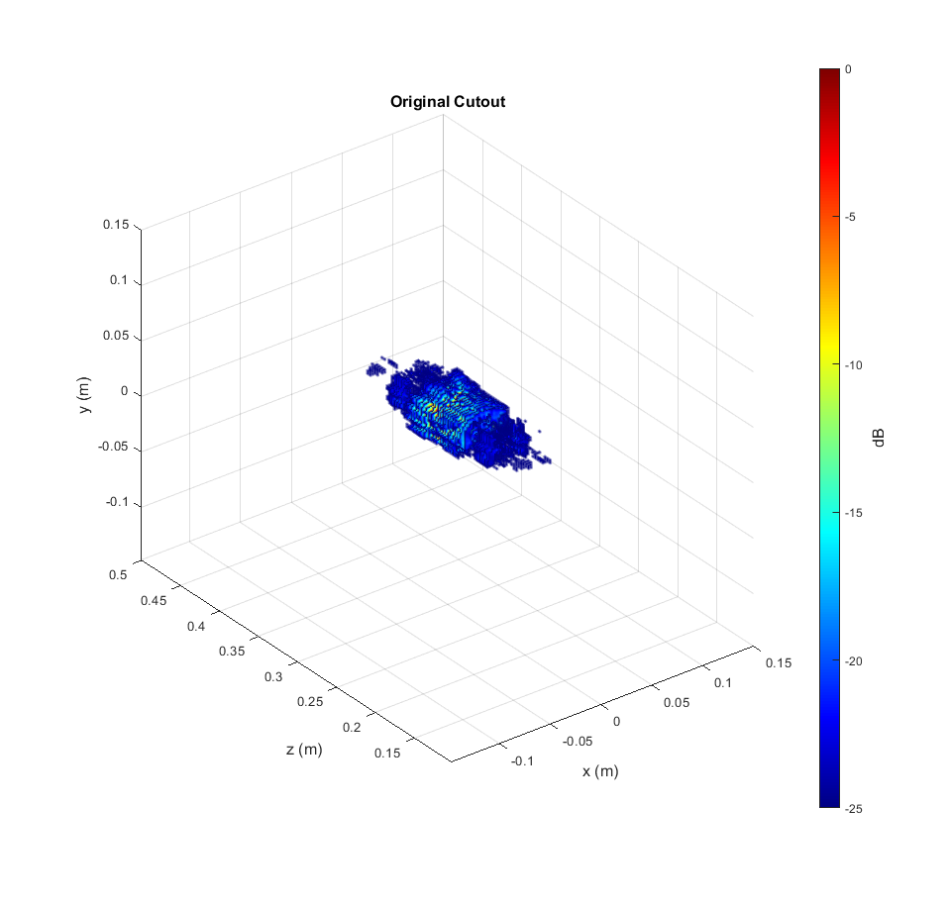
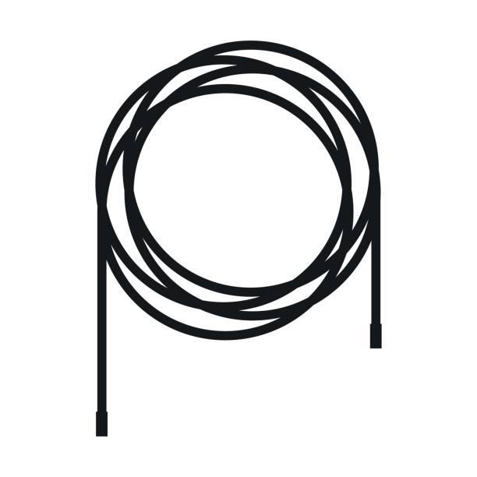
Results – Cable (Simulation)
Possible application: boxed item detection/counting
Cables inside of box
Cable assumed to be 2-D image
Echo signal simulated
Distortion in range (z) domain, caused by limited bandwidth, makes cable difficult to see

Slide 13
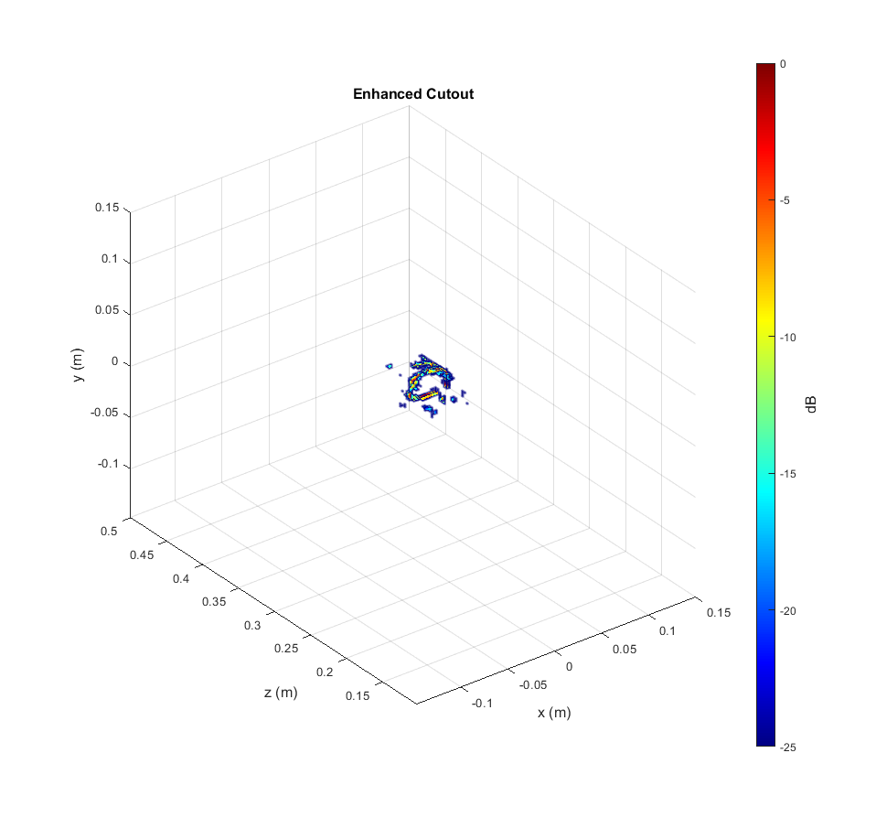
Results – Cable (Simulation)
Enhanced image allows the cable coil to be more clearly visible, but still not perfect
Structure shows “point-like” features
This is likely due to the fact that the network was only trained on point targets
Solution: train a new network with “solid” target and point targets

Slide 14
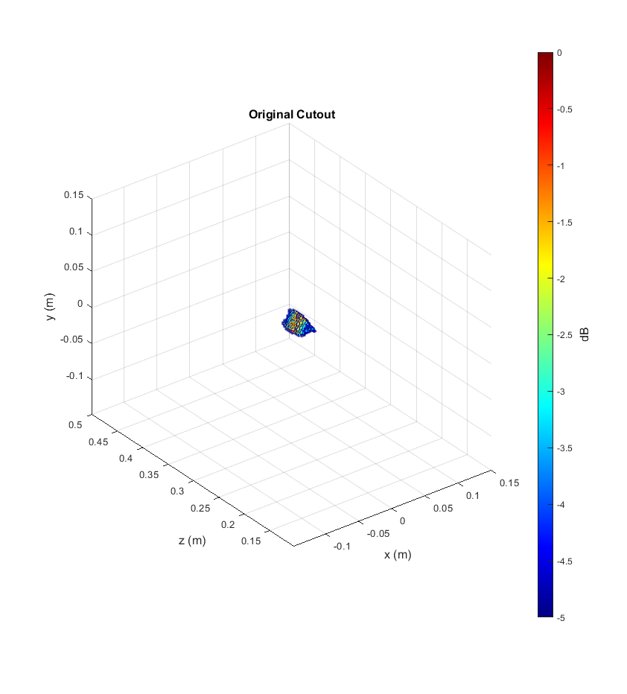
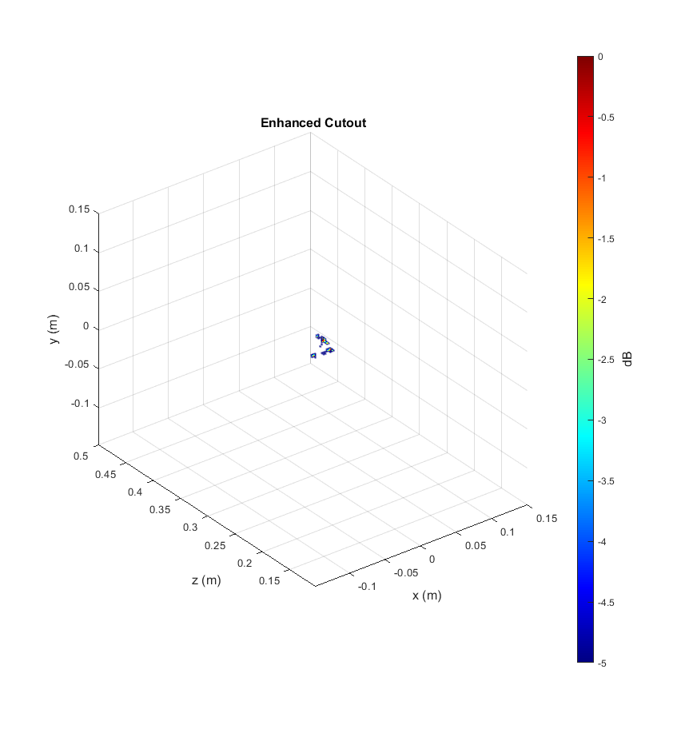
Results – Triangle Cutout (Simulation)
Again, we see an improvement, but still “point-like”

Slide 15
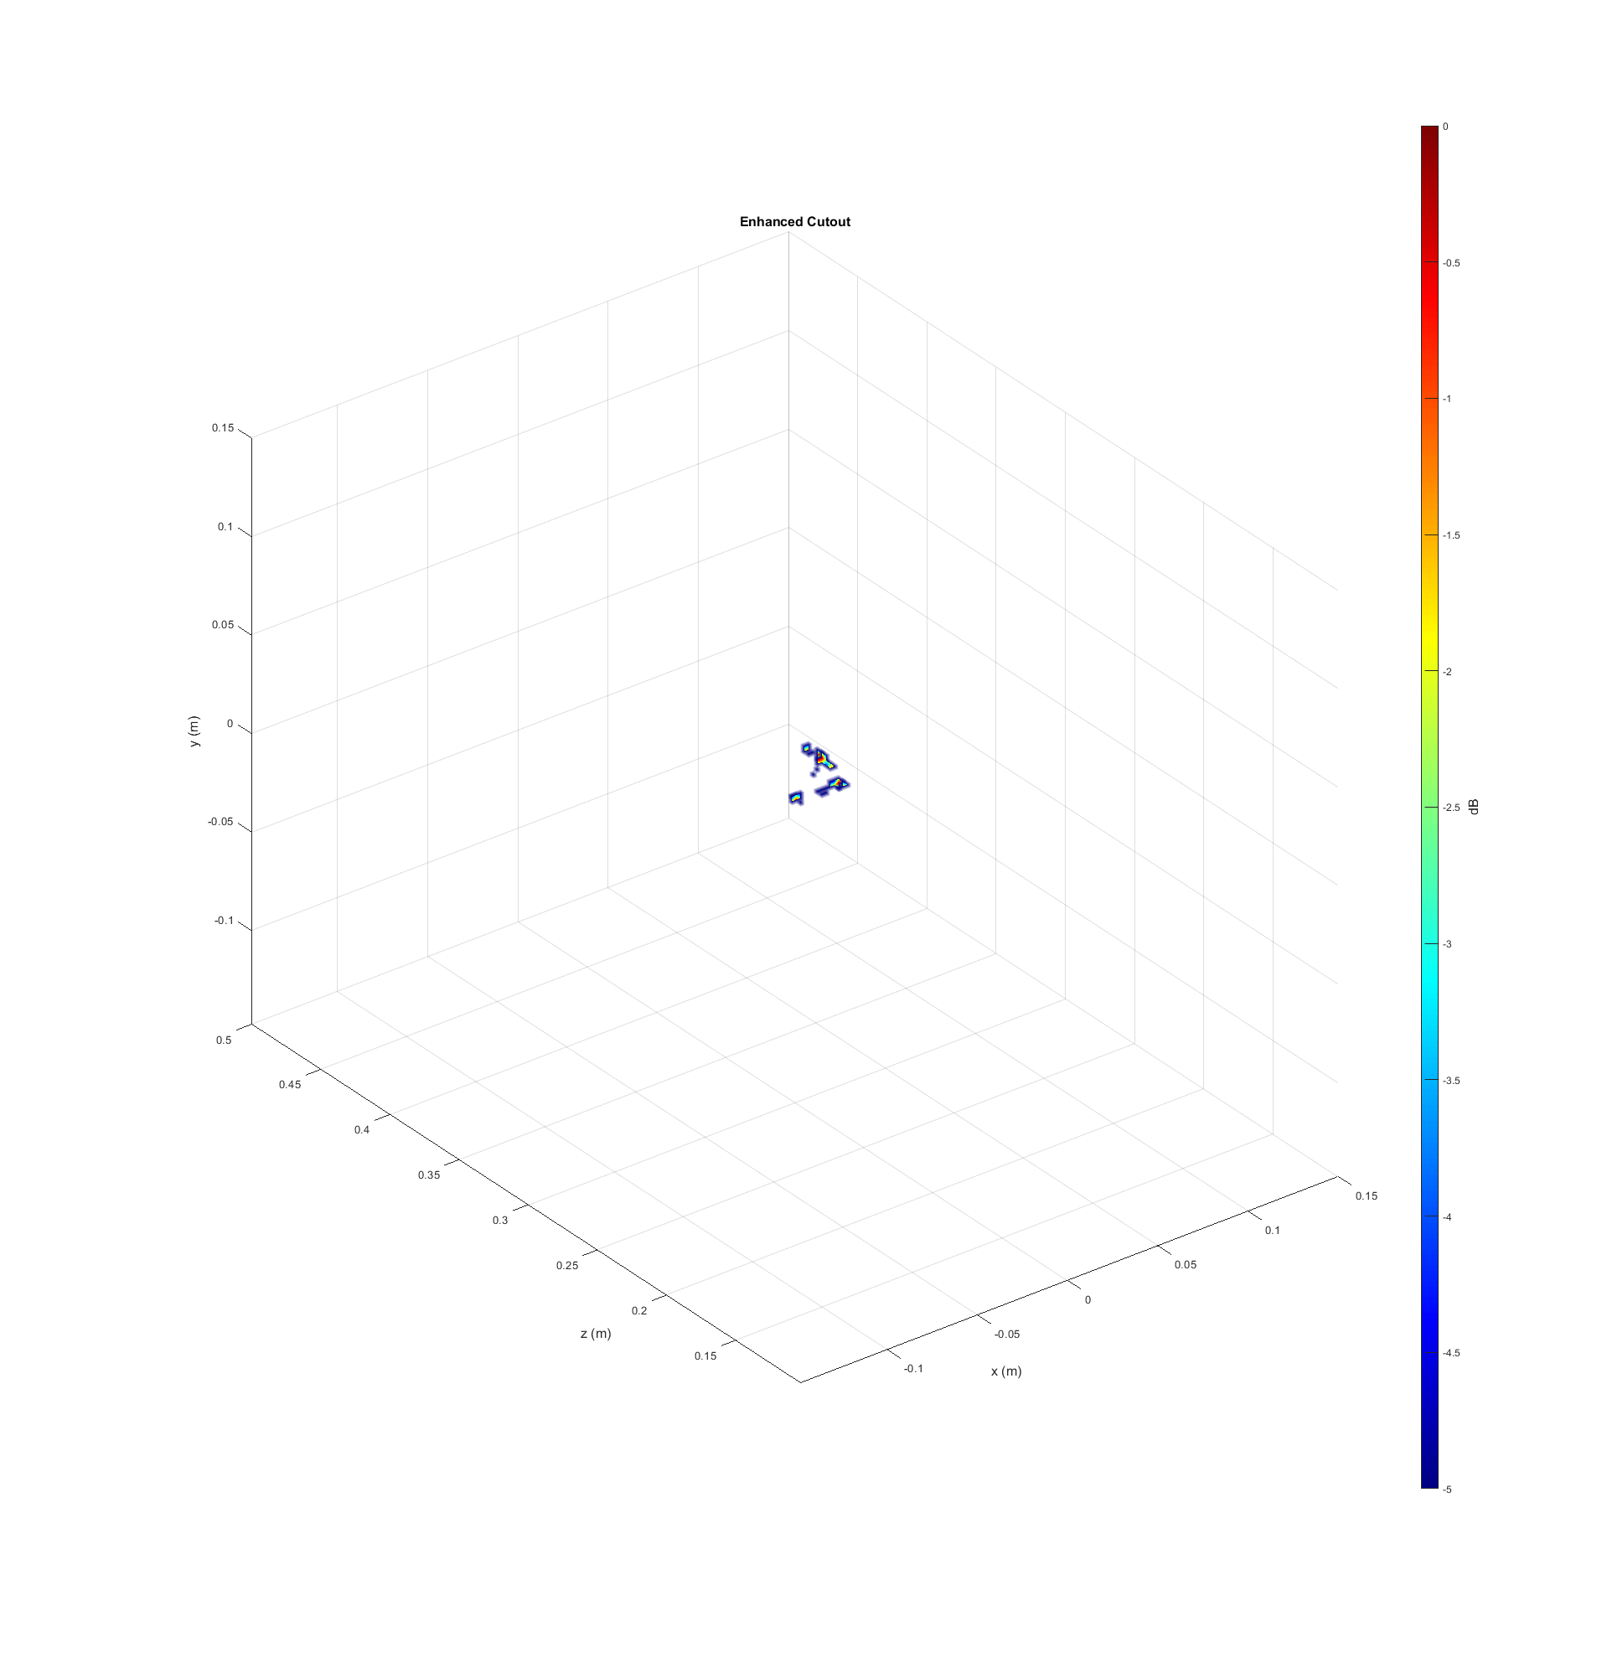
Triangle Cutout – Close Up
Outline of triangle is clearly visible, but “solid” face has been removed
How can we improve this?
Try training with solid objects!

Slide 16
Training with Solid Objects

Slide 17
Solid Flat Objects: Model – Challenges
Flat solid objects modeled as large set of ideal point reflectors
Key issue: Density of ideal point reflectors
Denser target = more energy concentrated in that region
More energy = larger side-lobes in range domain
Major implications in the reconstructed image for the 3-D case
FCNN Results
Outputs all zeros
Did not learn the distortion pattern
All zeros was the best guess

Slide 18
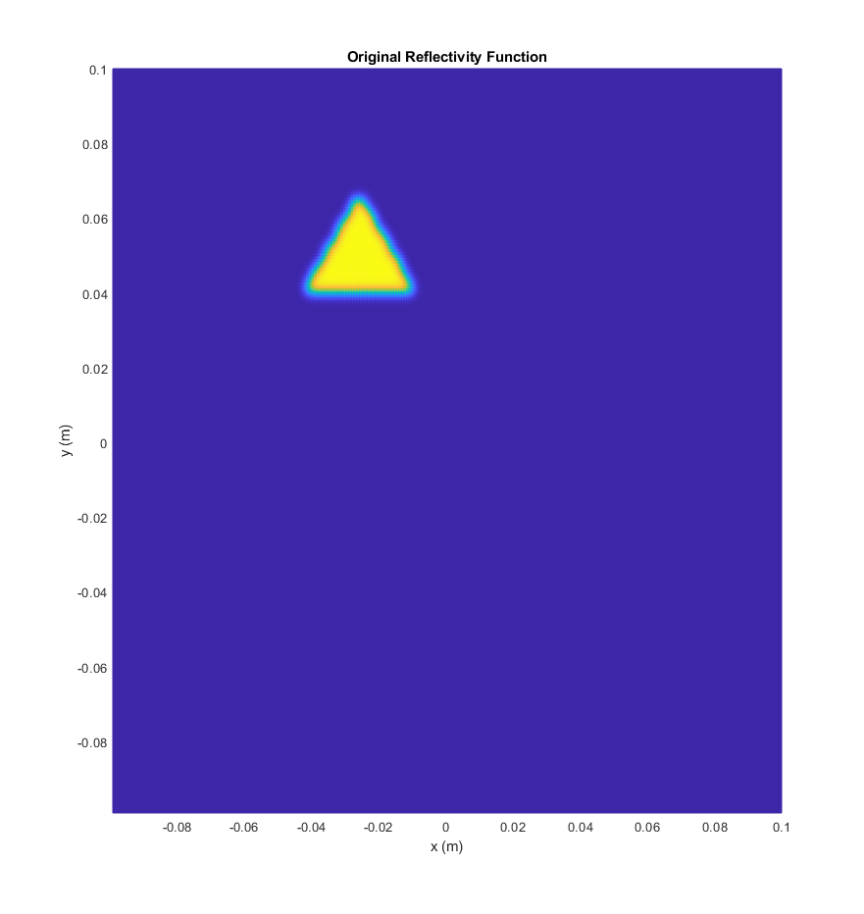
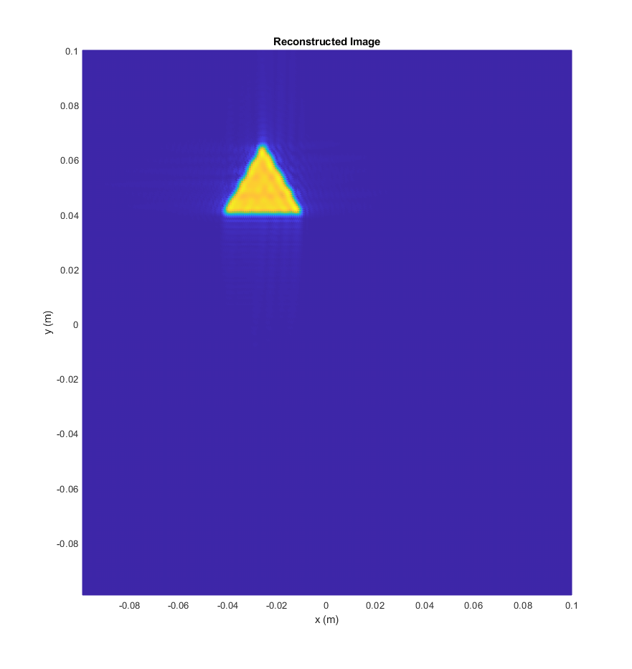
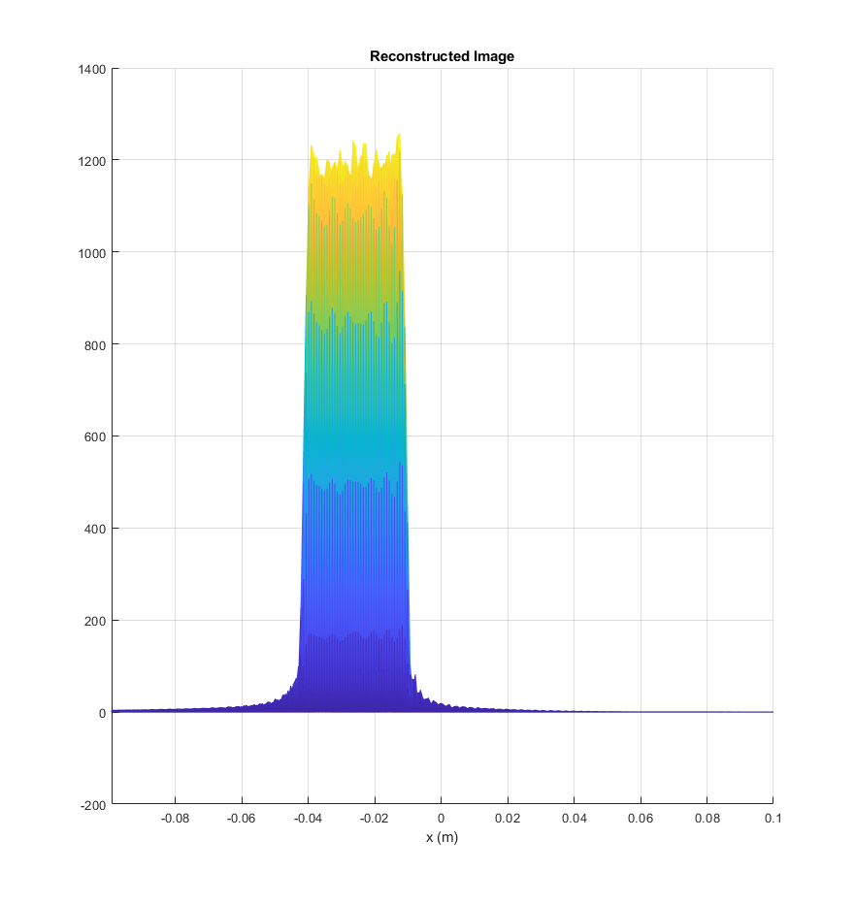
Examples – x4 Downsampling

Slide 19
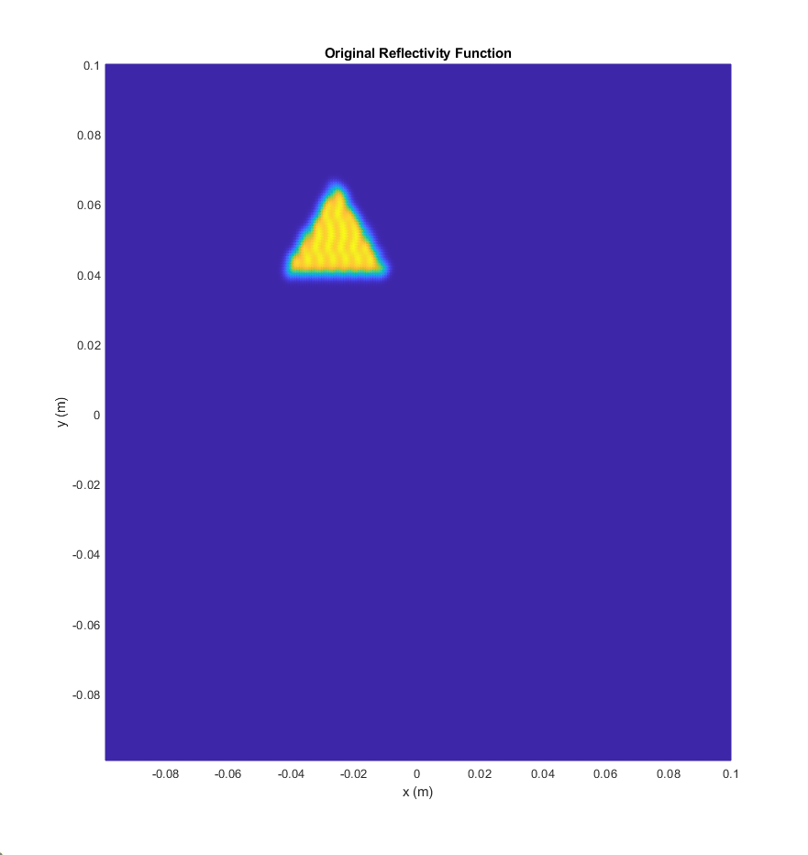
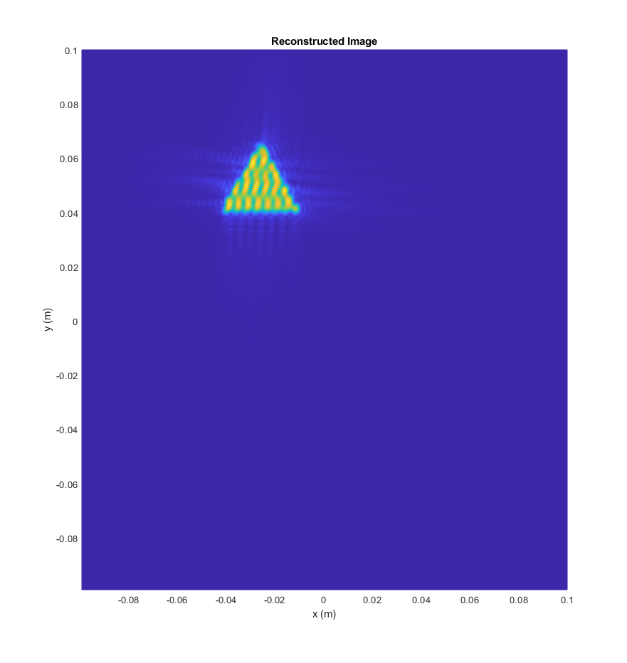
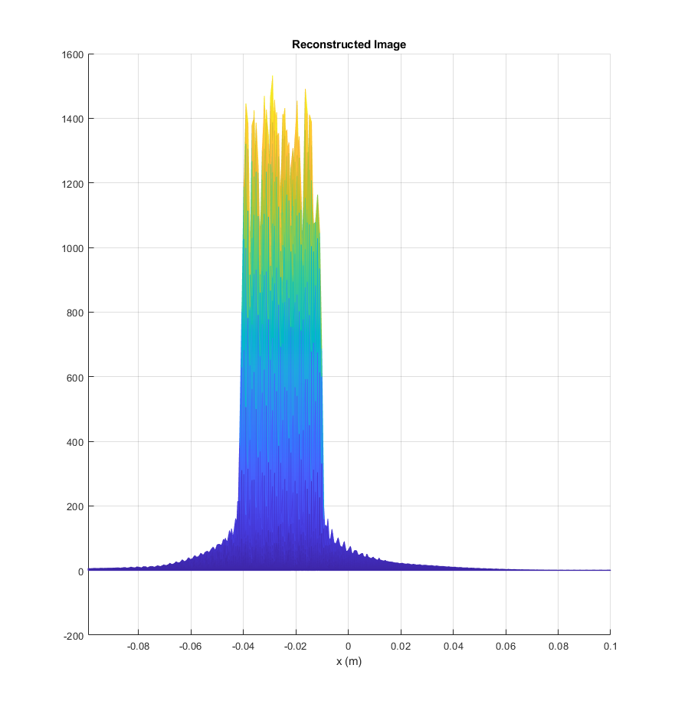
Examples – x8 Downsampling

Slide 20
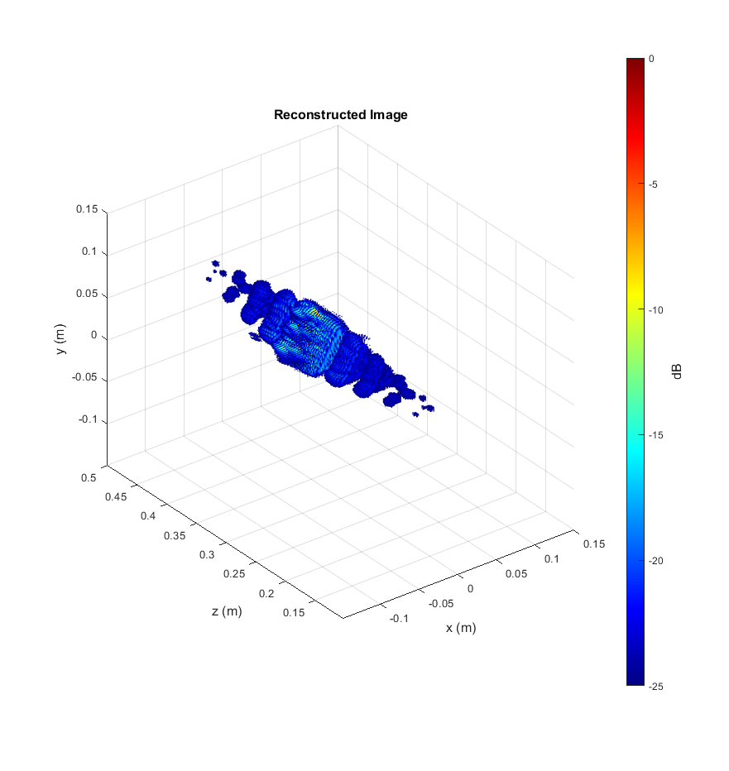
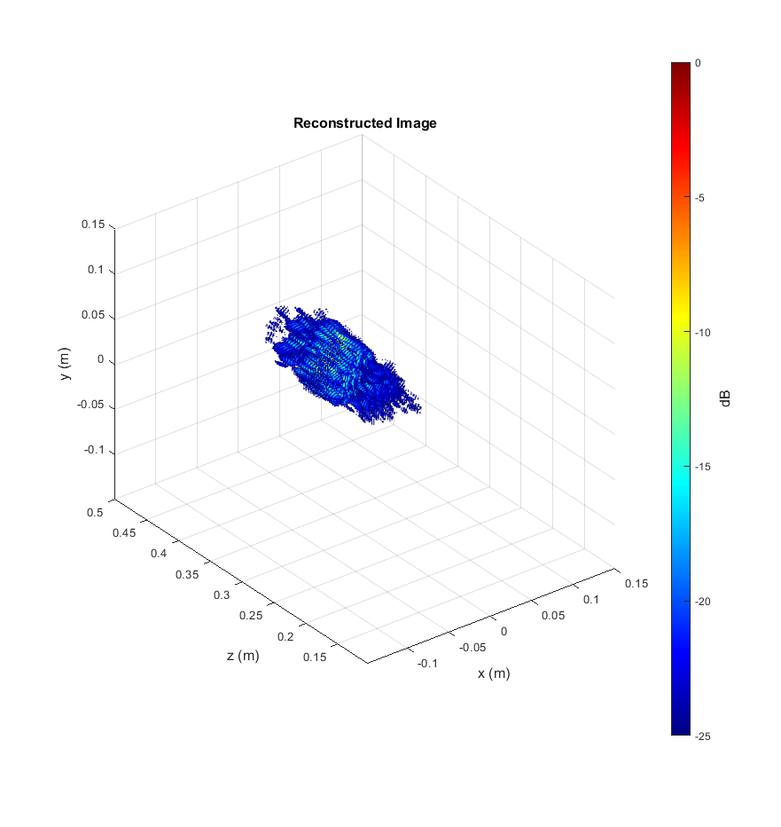
Examples – 3-D Comparison
x4 Downsampling
x8 Downsampling

Slide 21
Real Images from the Scanner

Slide 22
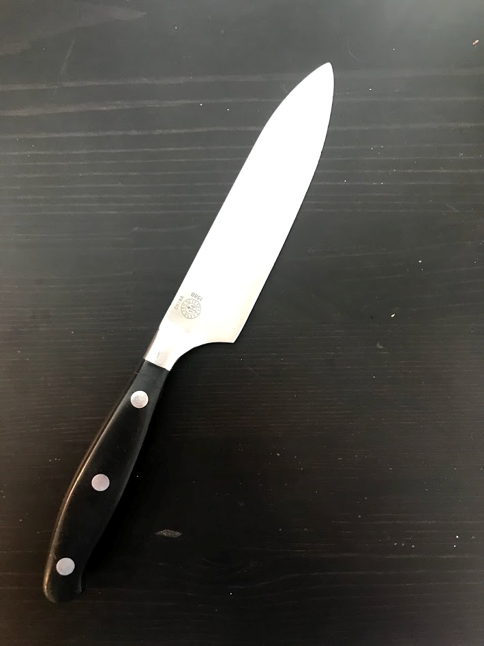
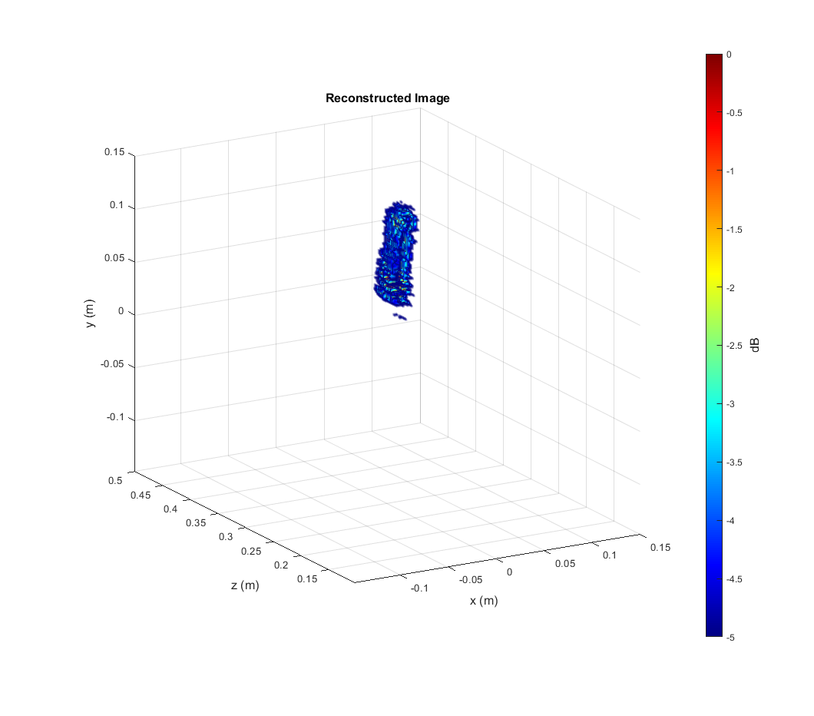
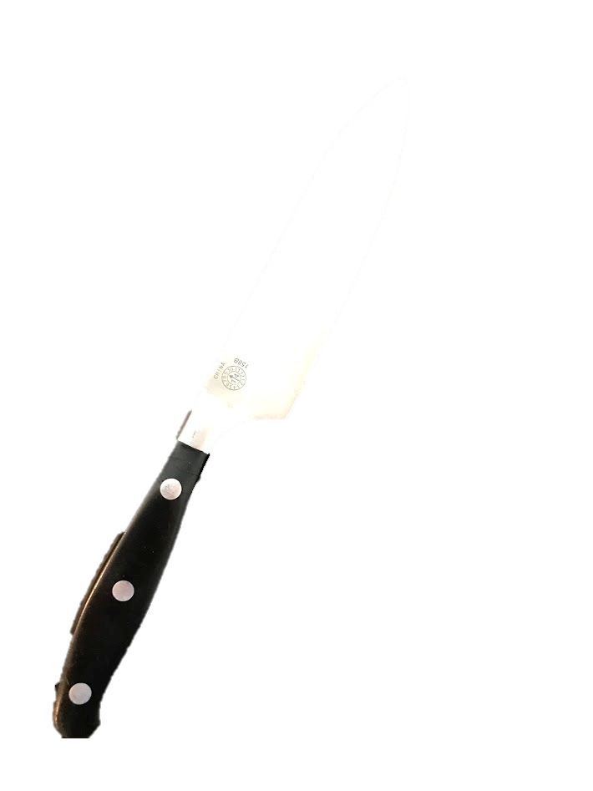
Result – Knife
Knife handle hidden behind PVC pipe holding the knife
Reconstructed image shows the knife blade

Slide 23
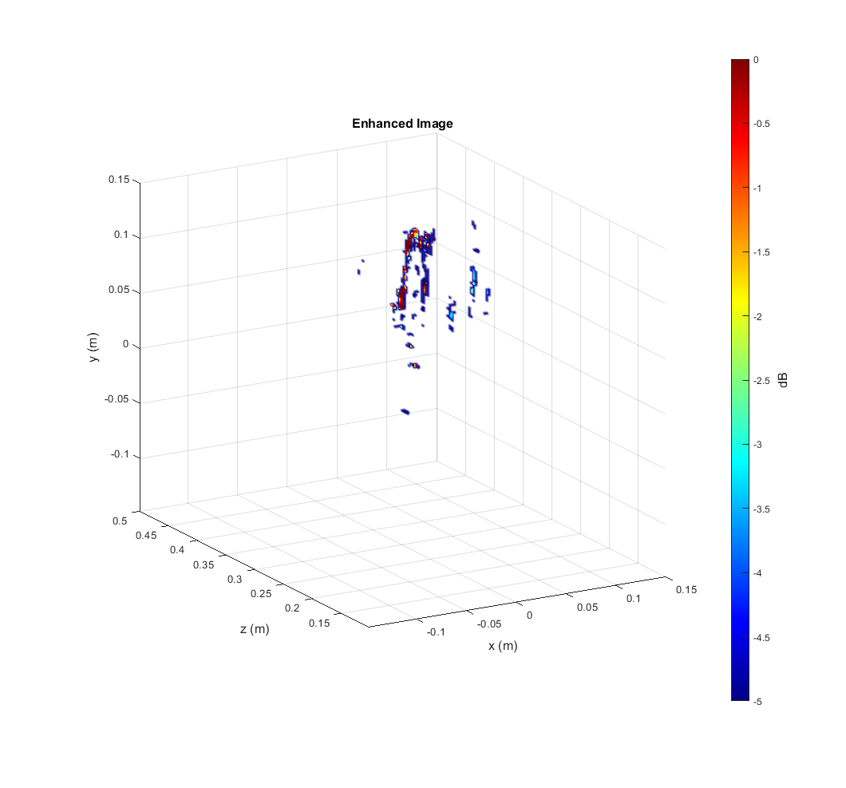
Results – Knife Enhanced
Pros:
Knife is roughly outlined, somewhat improving image from raw RMA image
Metal dots on handle are shown
Cons:
Some noise seems amplified
Don’t see solid blade face

Slide 24
Results – Knife Comparison

Slide 26
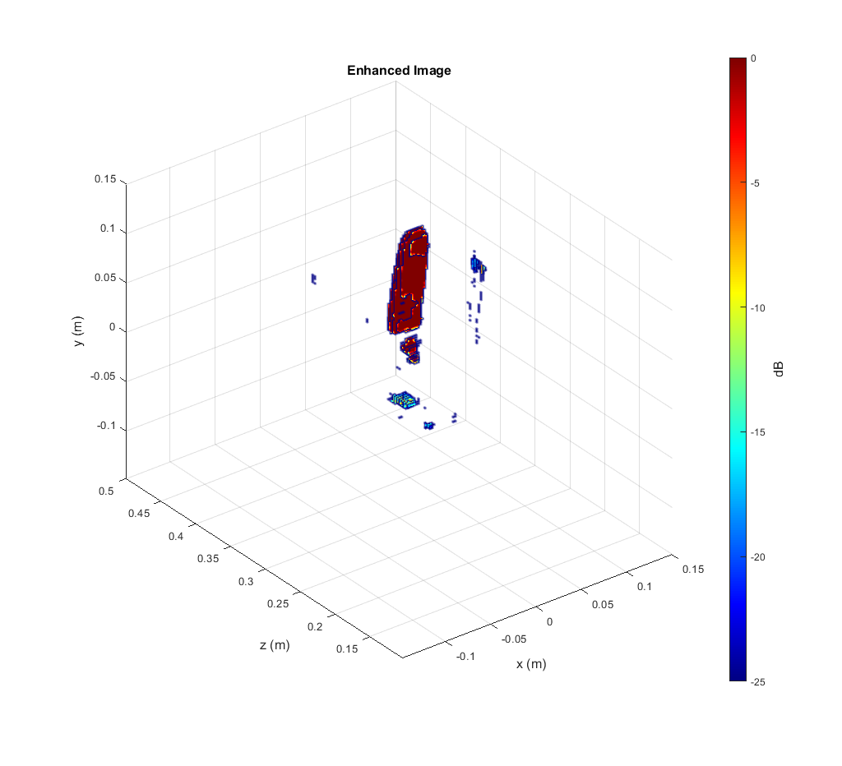
Old Network
New Network

Slide 27
New Network – PSF

Slide 28
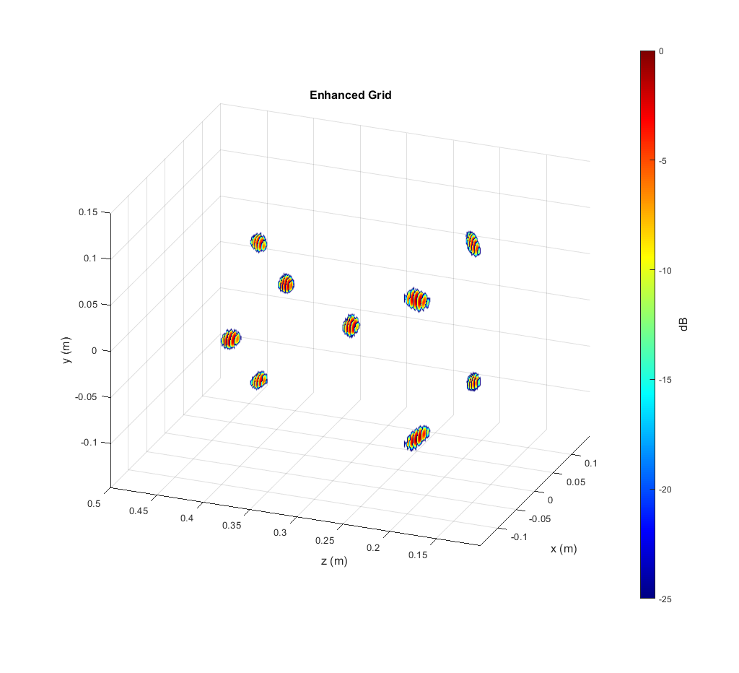
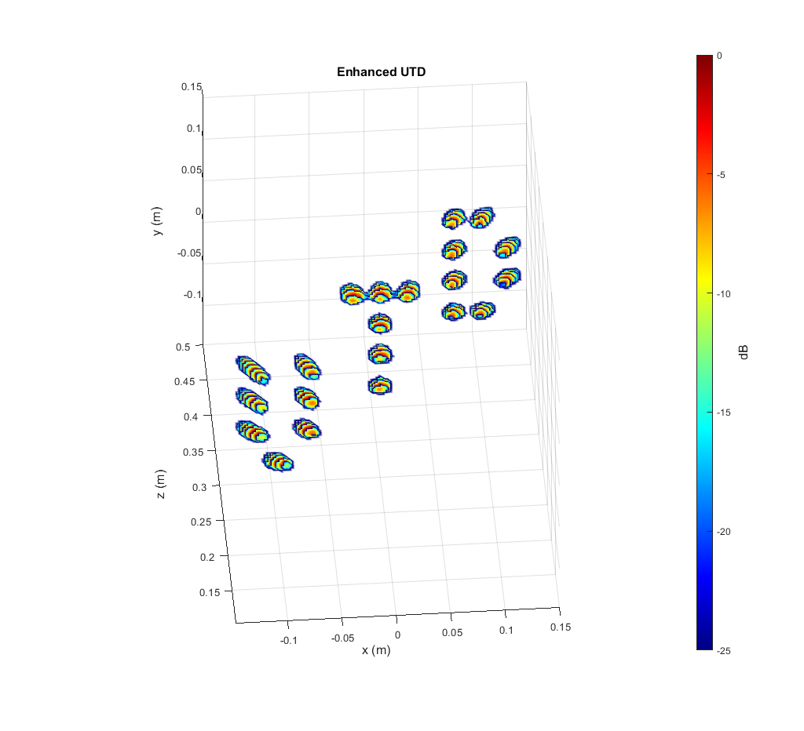
New Network – Grid and UTD

Slide 29
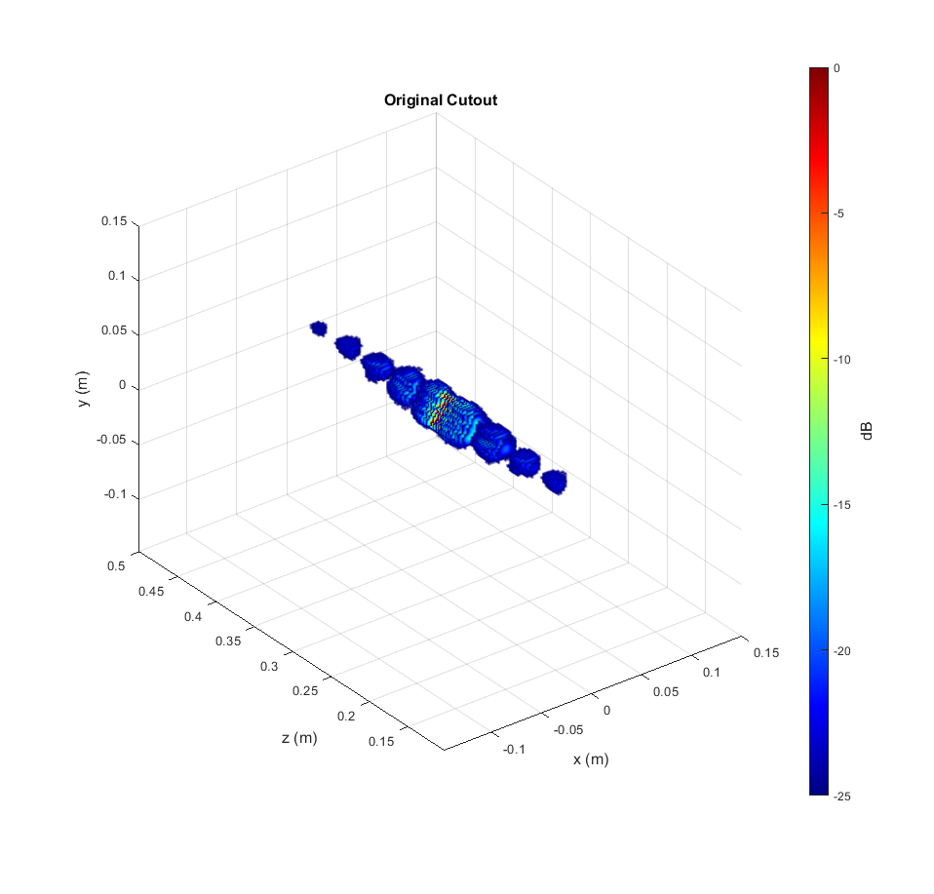
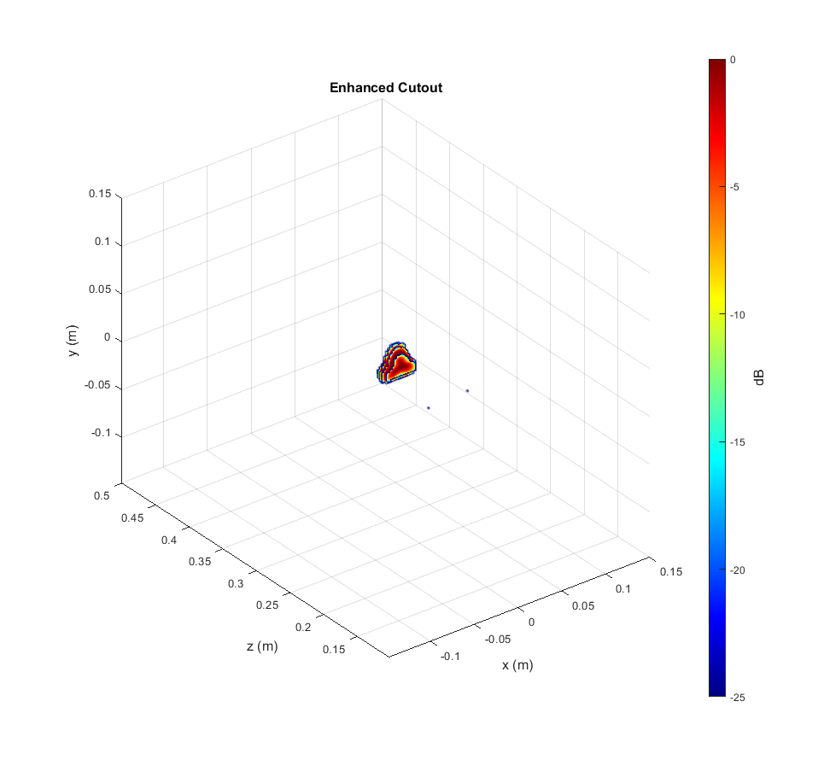
New Network – Triangle (Good)

Slide 30
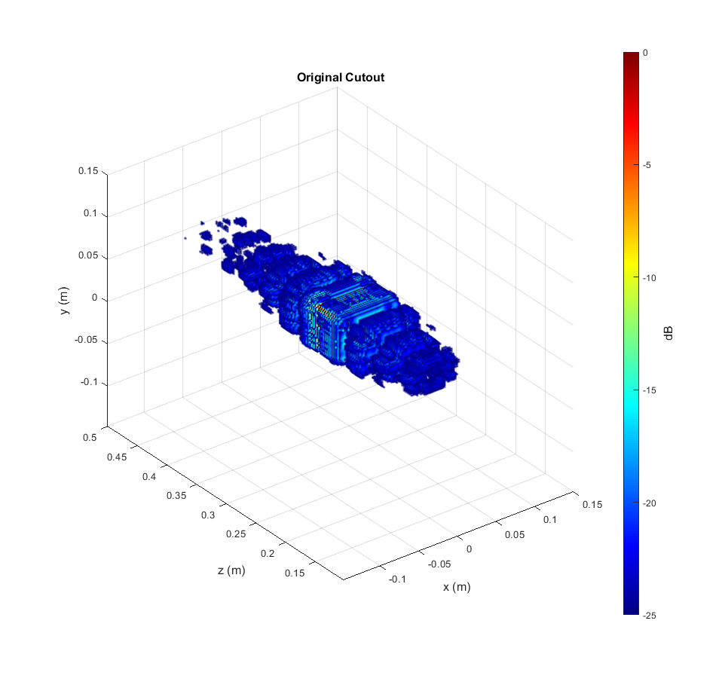
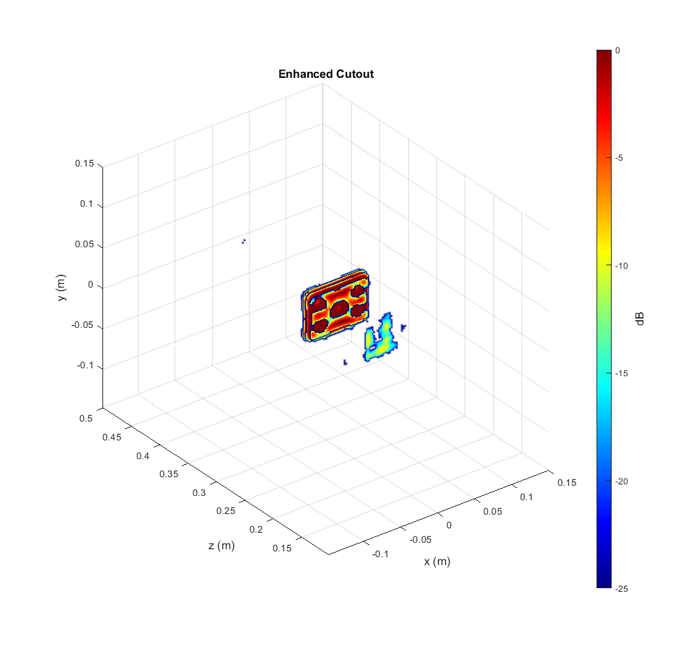

New Network – Cutout (Bad)

Slide 31


New Network – Cable (Bad)

Slide 32
Current Issues and Ideas
Training time: ~16 hours for 5 epochs
Need more computation power
Train on a cloud GPU compute cluster (super-computer)
Model for ideal flat surfaces
Train the FCNN with random points again, but with more random points
Train the FCNN with only solid flat surfaces
Generate data using advanced EM simulator
HFSS – installed, can interface with MATLAB
May be much slower and more difficult to automate

Slide 33
Questions
Training time: ~16 hours for 5 epochs
Does UTD offer access to a GPU compute cluster for this research?
Who should I contact?
Model for ideal flat surfaces
How can we generate the echo signals? Any ideas?
Which model best resembles the echo signal?
Needs to be efficient and an accurate model

Slide 34
Future Work
Train with cylindrical SAR scenario
How does the performance compare?
Is one better than the other?
Can we train an FCNN to work with both SAR and CSAR?
Train with different chirp parameters
How different is the distortion based on the chirp parameters?
Can we train an FCNN to work with any chirp parameters?

Slide 35

Questions?

